Slide 1
Built-In Variables in Python
By Bhimashankar Takalki

Slide 2
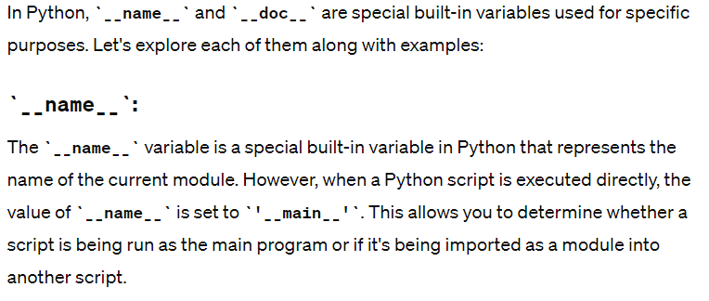

Slide 3
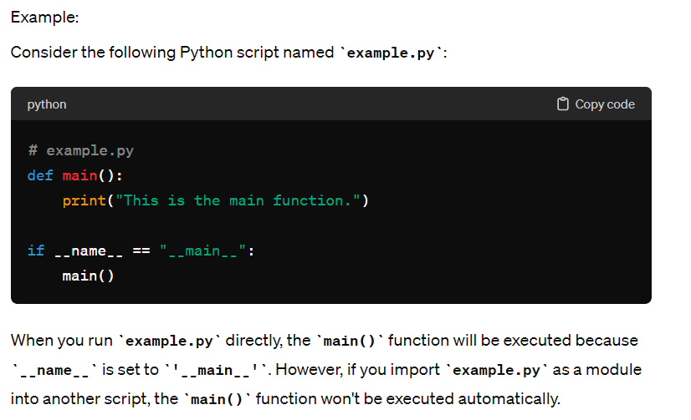

Slide 4
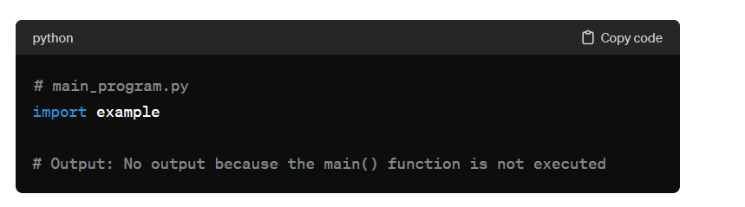

Slide 5
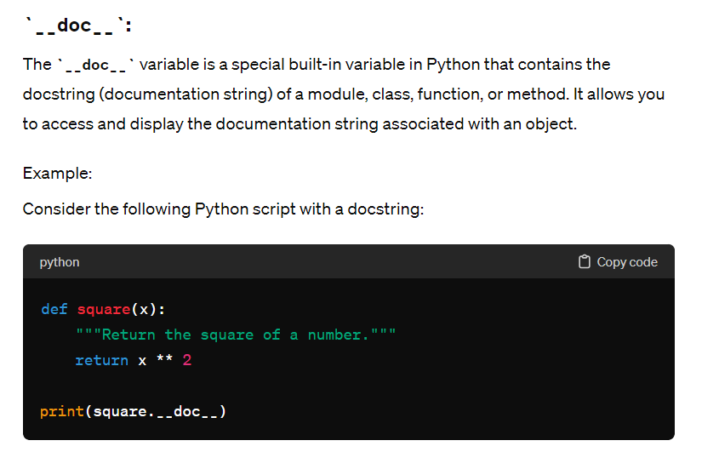

Slide 6
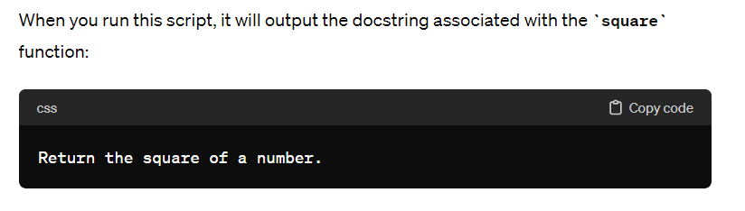

Slide 7
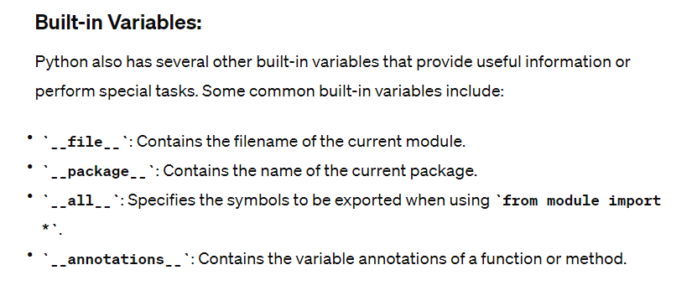

Slide 8
# example.py
print("__file__:", __file__)
print("__package__:", __package__)
print("__all__:", __all__)
print("__annotations__:", square.__annotations__)

